Slide 1




Project Credit Card Churn
Group 5
Abhradeep Das G38747350
Gouri Dumale G49564205
Smit Pancholi G31443926
Swathi K R G48428717

Slide 2
1
Introduction
2
Data & Methodology
3
Results
4
Conclusion
Presentation Line Up

Slide 3
Introduction
What is Credit card churn ? In simple terms, credit card churn is when people sign up for a new credit card, use it for a while, and then cancel or stop using their old one.
What do we gain ? Customers try to get the best deal out of the products available in the market such as lower interest rates , rewards , cashback etc. by churning through different credit cards.
Why is it an issue ? As customers don’t end up paying interest/minimal fees or discard cards after sign up bonuses , the financial institutions don’t gain any profit from these customers.

Slide 4
Data and Methodology
Understanding and Predicting Credit Card Churn Project Overview
Dataset: Obtained from Kaggle, covers 10,127 clients.
Client Attributes: Age, gender, education, marital status, and income categories.
Credit Card Usage Patterns:
Includes credit limits, transaction amounts, and card categories.
Banking Relationships:
Examines total relationships and periods of inactivity.

Slide 5
Data and Methodology
Logistic Regression is a binary classification method with a linear decision boundary, offering probabilistic outputs. It extends to Multinomial logistic regression for multiclass tasks and employs regularization for robustness. Evaluation metrics include accuracy, precision, recall, F1-score, and ROC-AUC.
Decision Tree is a versatile predictive modeling tool used for both classification and regression tasks. It features a tree-like structure, providing interpretability and facilitating feature selection. In classification, it employs the Gini impurity metric, while in regression, it uses the mean squared error for evaluating model performance.

Slide 6
Data and Methodology
Random Forest is an ensemble learning method for classification and regression tasks. It forms a forest of decision trees, preventing overfitting and ensuring robustness. With advantages of resilience, reduced sensitivity to noise, and scalability for large datasets, it utilizes mode for classification and mean for regression, providing feature importance scores for enhanced interpretability.

Slide 7
Exploratory Data Analysis
Exploratory Data Analysis (EDA) is an initial approach to analyze datasets for insights and patterns.
EDA involves data summarization, description, and visualization techniques.
Essential for informing subsequent analysis, modeling, or hypothesis testing.

Slide 8
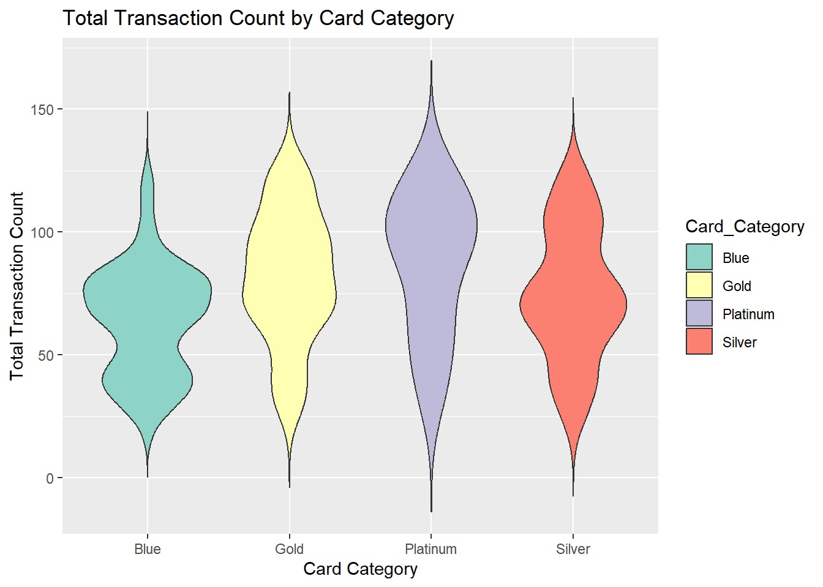
1. Blue Card Category
Wide base indicates high frequency of lower transaction counts.
Tapers off as transaction count increases.
2. Gold Card Category
More uniform distribution. Less pronounced peak suggesting an even spread of transaction counts.
3. Platinum Card Category
Narrow shape implies lower frequency of cardholders with varying transaction counts.
4. Silver Card Category
Wide distribution similar to Blue but with fewer extreme values.

Slide 9
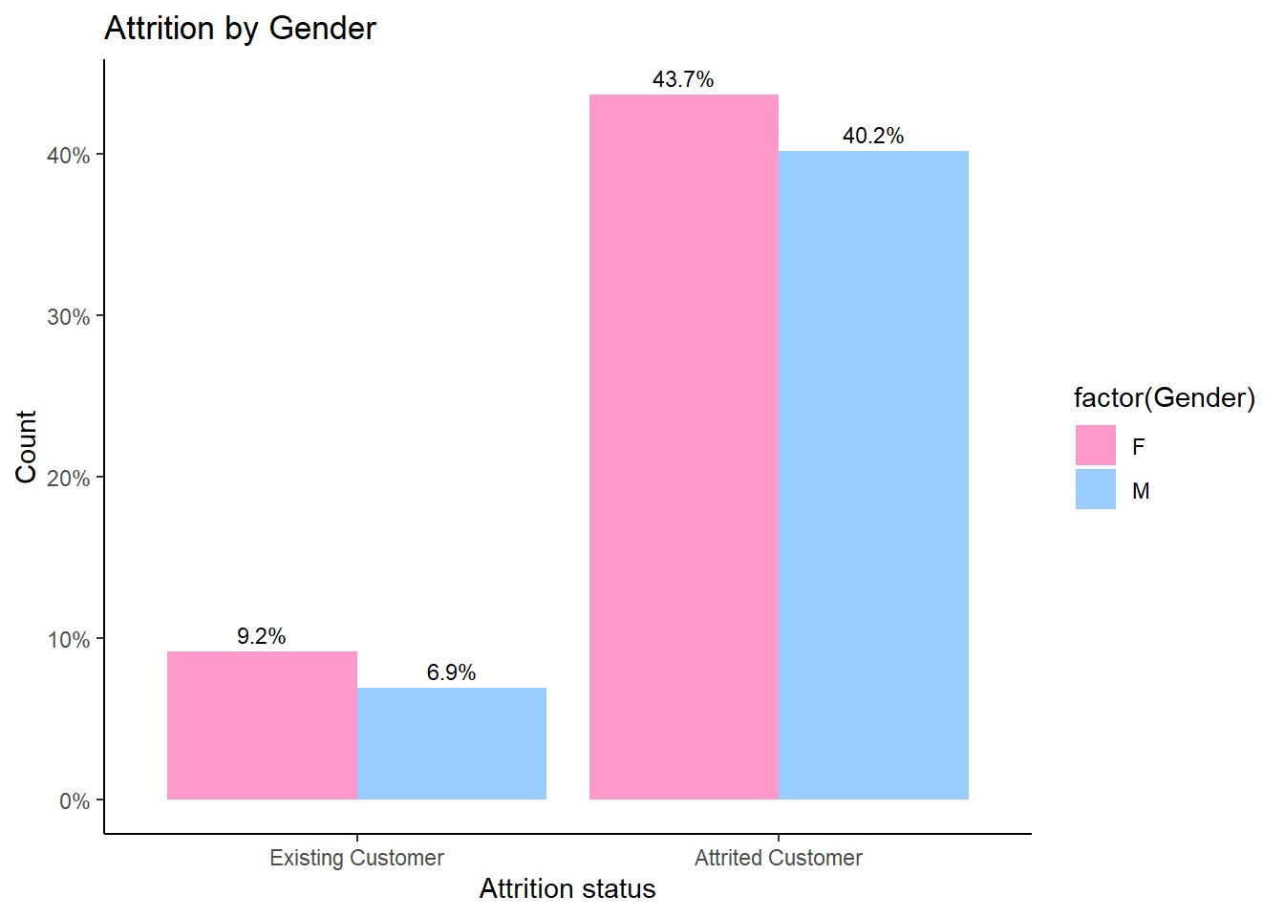
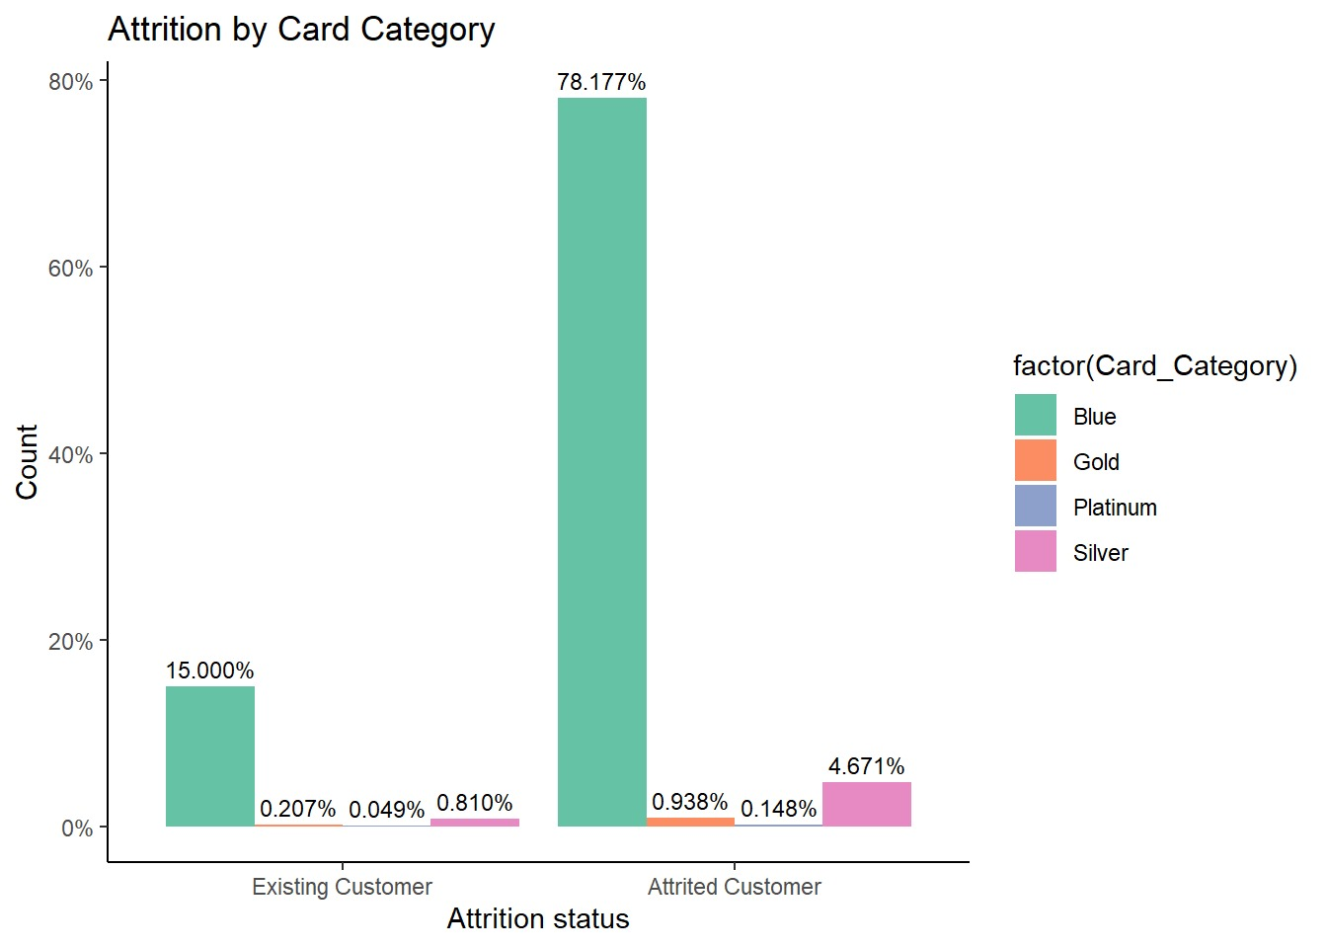

Slide 10
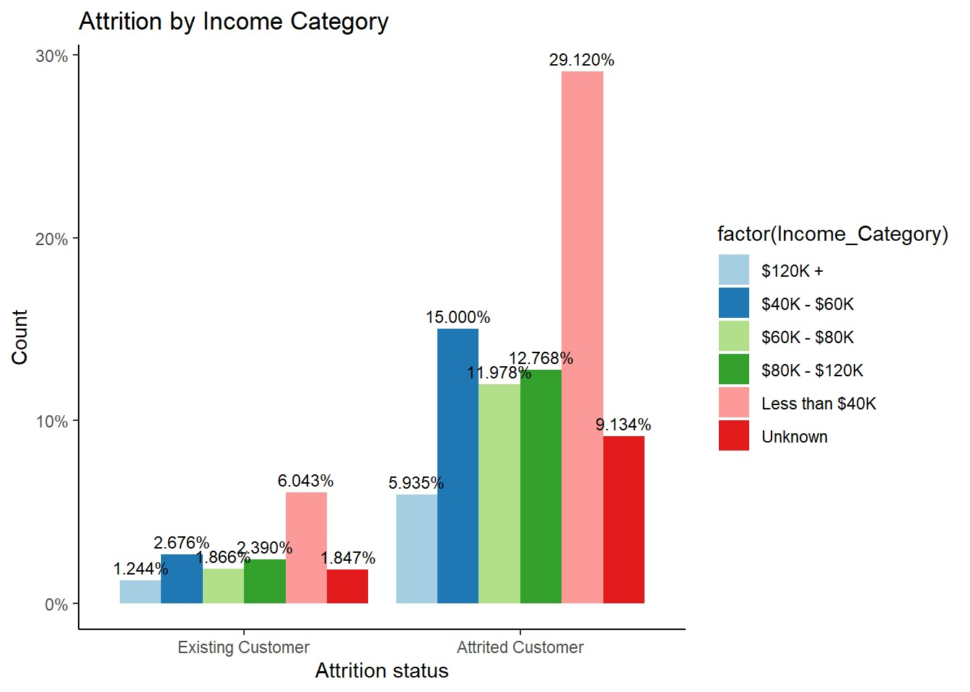
Among existing customers, the highest percentage falls within the $40K - $60K income category (6.043%), and the lowest percentage is in the $120K+ category (1.244%).
For attrited customers, the largest group by far is in the Less than $40K income category (29.120%).

Slide 11
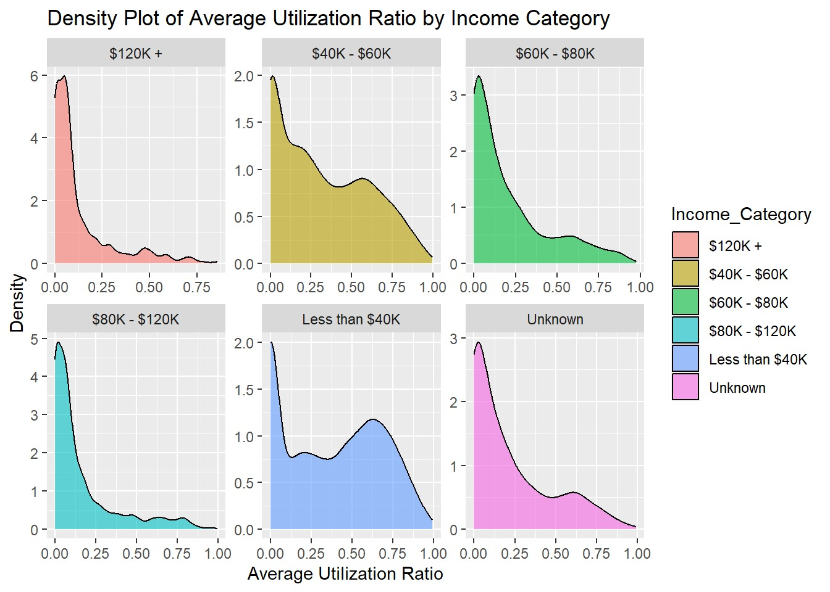

The "$120K+" category (red) has a peak at a low utilization ratio, indicating that most high-income earners have a low credit utilization ratio.
The "$40K - $60K" (yellow) and "$60K - $80K" (green) categories also show peaks at lower utilization ratios, but the spread is wider.
The "$80K - $120K" category (cyan) shows a similar pattern, with most individuals having a low utilization ratio.
The "Less than $40K" category (blue) has a wider distribution, indicating a more varied utilization ratio among lower-income earners.
The "Unknown" income category (pink) shows a substantial number of individuals across a range of utilization ratios, with a peak at a lower ratio.

Slide 12
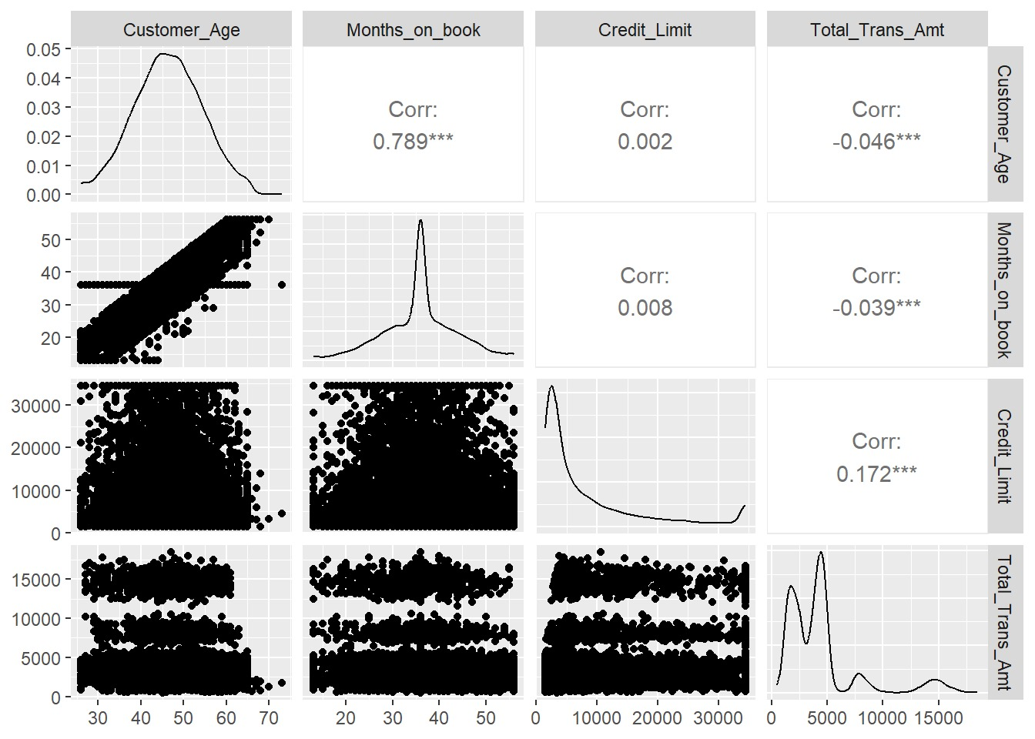
Correlation Analysis
The chart provided here, is a matrix of scatter plots and histograms known as a pairs plot or a scatterplot matrix, combined with correlation coefficients.
The correlation coefficient between Customer age and Months on book is 0.789, indicating a strong positive correlation.
The correlation coefficient is 0.172, suggesting a weak positive correlation between credit limit and total transaction amount.

Slide 13
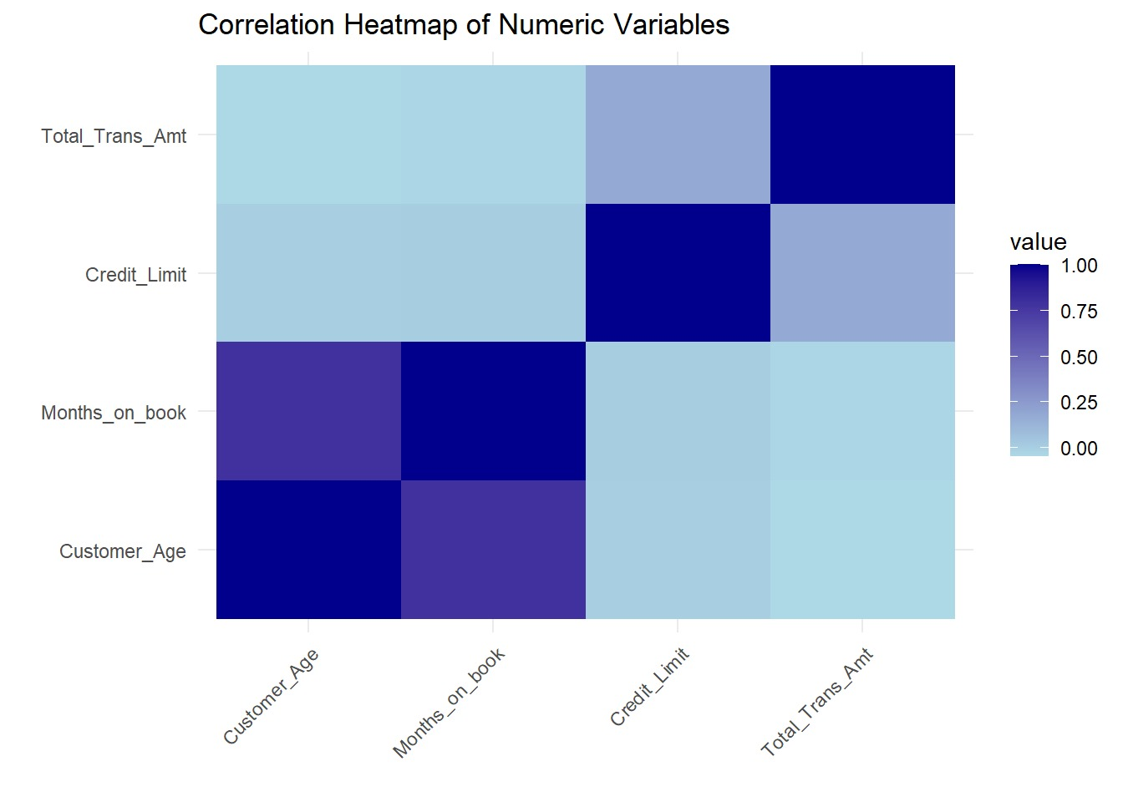

Slide 14
Results
This section presents the outcomes and findings obtained from employing various machine learning algorithms for predicting credit card churn.
The primary objective of this study was to develop models capable of accurately identifying potential churners in the credit card customer base.
Additionally, three distinct machine learning models, namely Random Forest, Decision Tree, and Logistic Regression, were utilized for this predictive analysis.

Slide 15
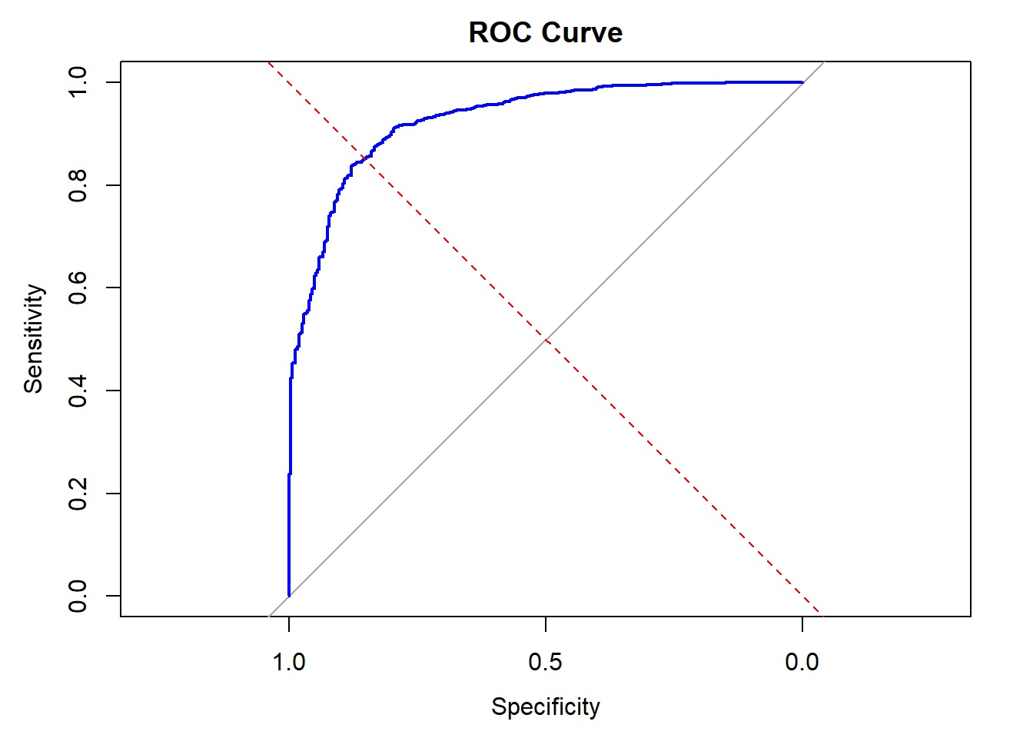
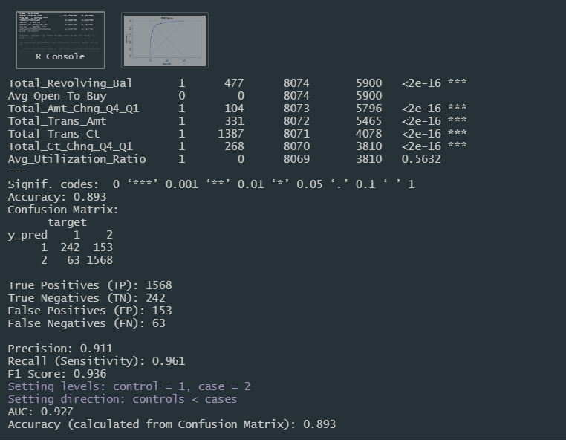
Logistic Regression

Slide 16
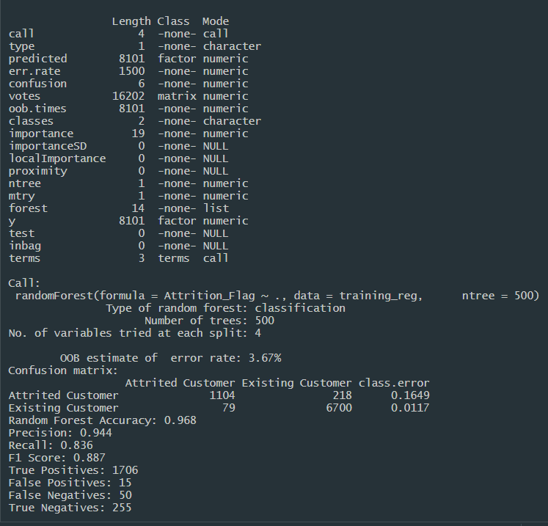
Random Forest
The random forest model achieves high accuracy (96.8%) in predicting the "Attrition_Flag.“
The precision, recall, and F1 Score indicate good performance in classifying both "Attrited Customer" and "Existing Customer" categories.

Slide 17
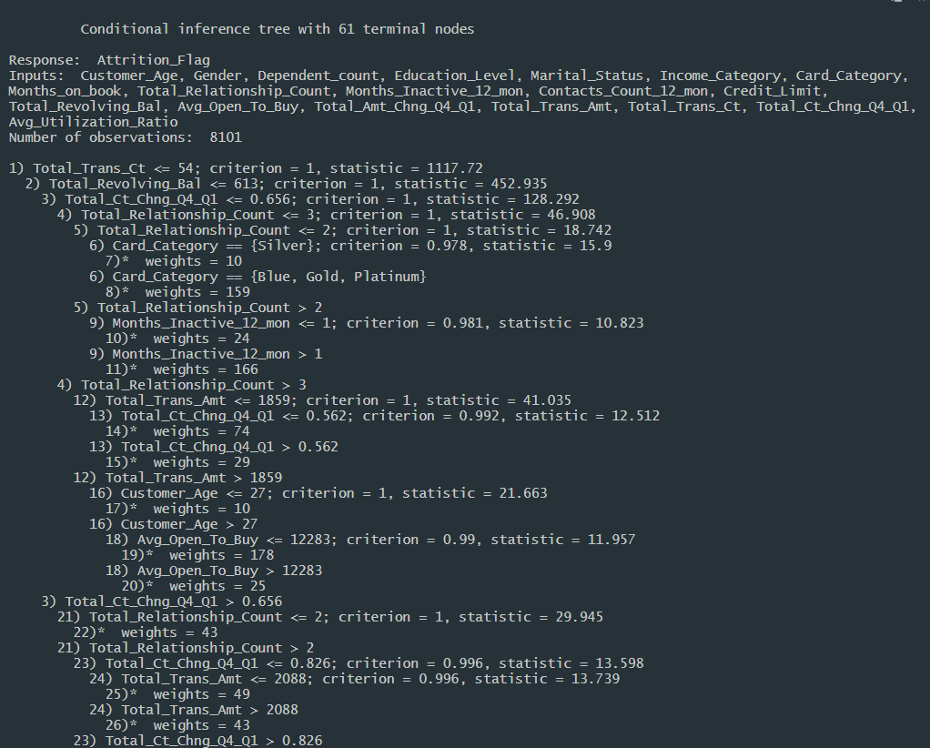
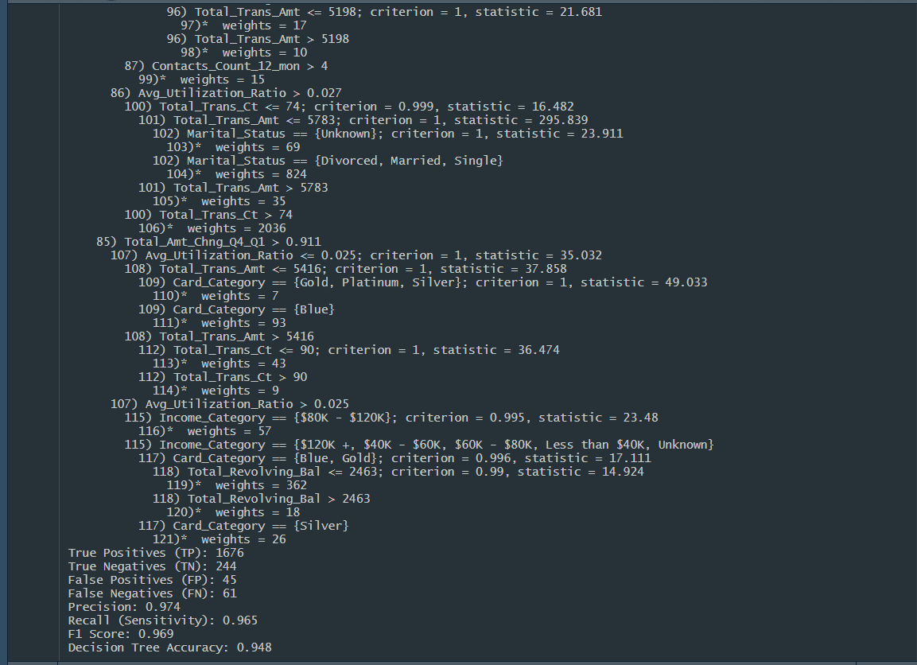
Decision Tree

Slide 18
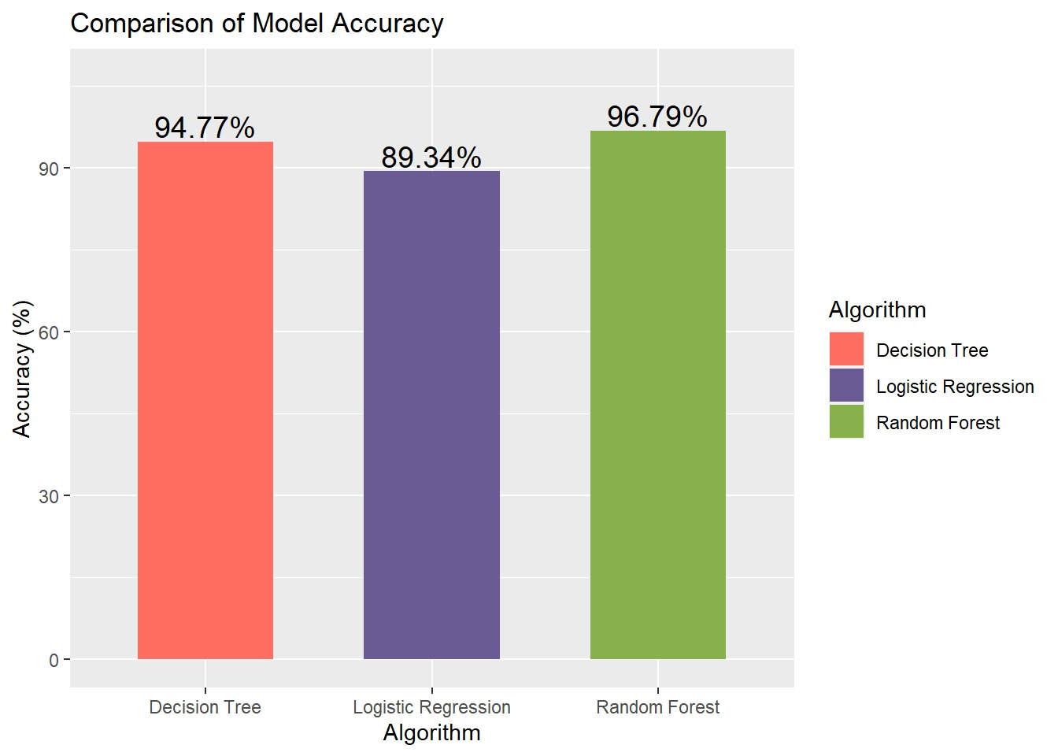
Model | Accuracy
Decision Tree | 94.77%
Logistic Regression | 89.34%
Random Forest | 96.79%
Key Insights:
Random Forest outperforms other models in accuracy, achieving the highest accuracy of 96.79%.
Decision Tree and Logistic Regression models also show commendable accuracy levels.

Slide 19
Conclusion
The findings suggest that machine learning models, particularly Random Forest, hold promise in accurately predicting customer churn, which is crucial for businesses in managing customer relationships and retention strategies.

Slide 20
Thank You ☺

